Slide 1

Exploratory Data Analysis
G2M Case Study
Virtual Internship
21st June 2023

Slide 2
Background And Information About Data
XYZ is a private firm in US. Due to remarkable growth in the Cab Industry in last few years and multiple key players in the market, it is planning for an investment in Cab industry, and they want to understand the market before taking final decision.
Time period of data is from 31/01/2016 to 31/12/2018.
Each data set represents different aspects of the customer profile.
Cab Data – this file includes details of transaction for 2 cab companies
Customer ID – this is a mapping table that contains a unique identifier which links the customer’s demographic details
Transaction ID – this is a mapping table that contains transaction to customer mapping and payment mode
City – this file contains list of US cities, their population and number of cab users
XYZ is interested in using your actionable insights to help them identify the right company to make their investment.

Slide 3
Hypothesis
Profit analysis: Profit analysis of a firm is the topmost criteria if we are looking to invest in a company.
Number of rides analysis: Total transactions also define profits and popularity of the company.
Customer analysis: As this industry is customer service driven, we need to focus on customers preferences towards the companies.
Geographic location analysis: Geographic location plays an important role for the development of any industry.
Holiday Analysis: Customer preferences and profit earned during holidays are compared.

Slide 4
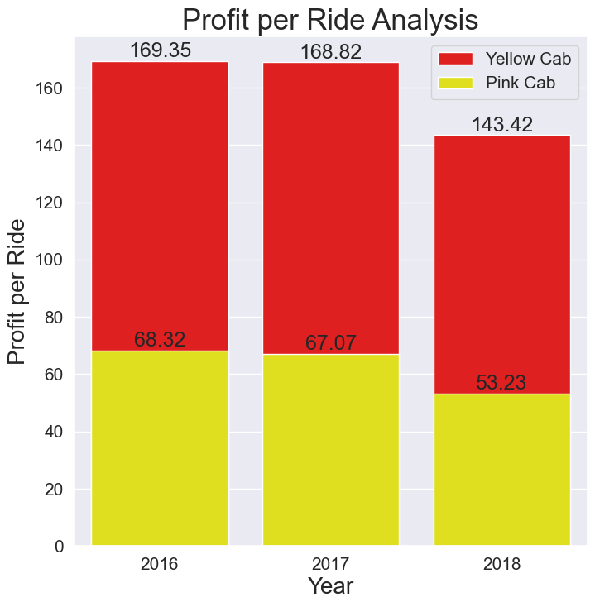
Profit per ride analysis

Slide 5
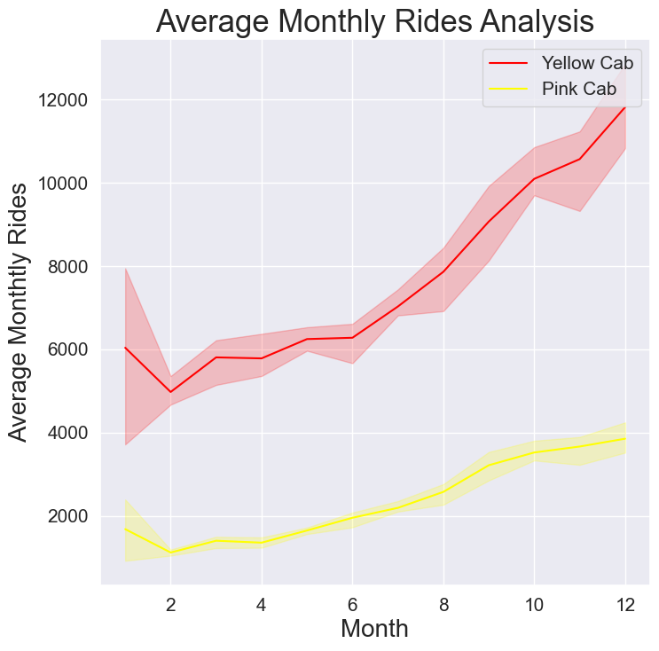
Average monthly ride analysis

Slide 6
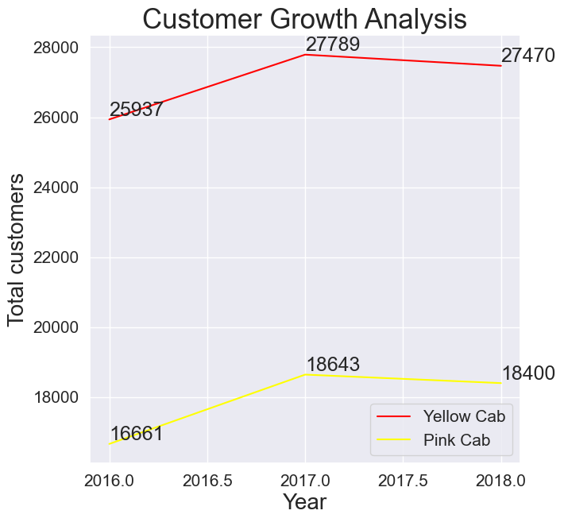
Customer growth analysis

Slide 7
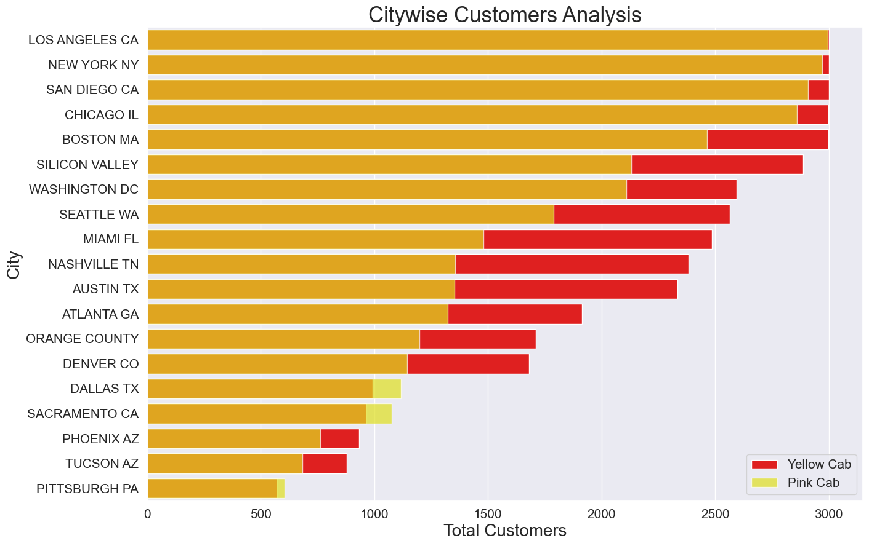
Citywise customer analysis

Slide 8
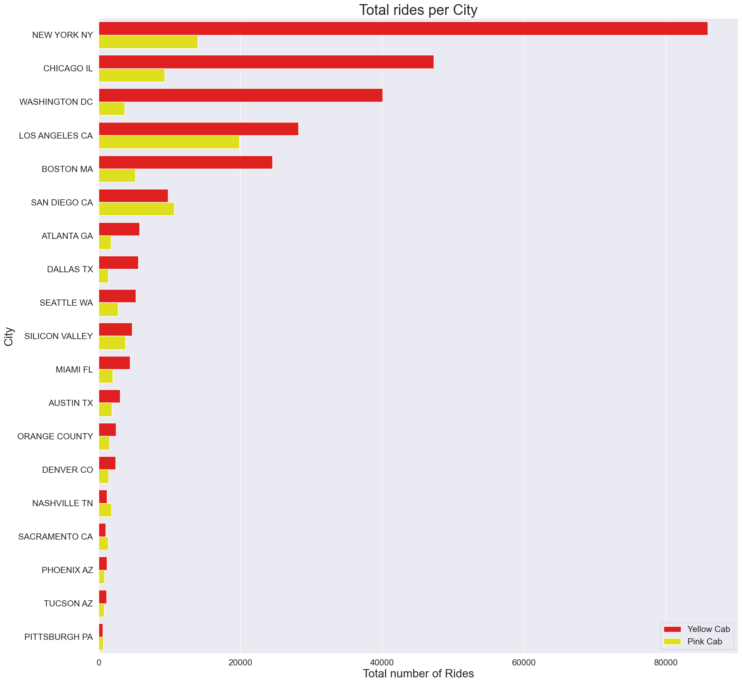
Total rides per city

Slide 9
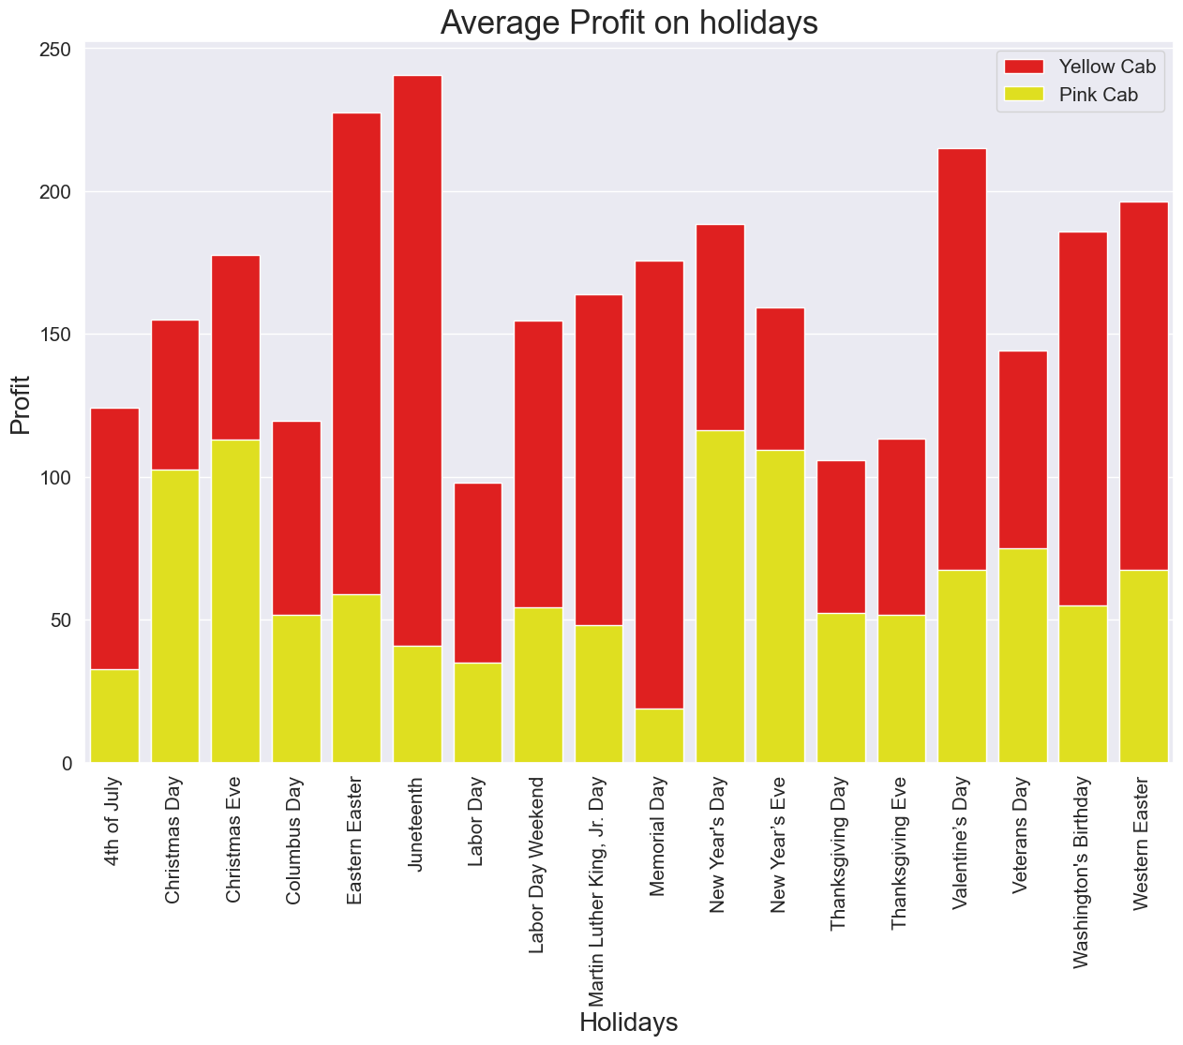
Average profit on holidays

Slide 10
Recommendat-ions on the hypothesis
Profit Analysis: In this analysis, we compared annual profit, quarterly profit, per Kilometer profit, per ride profit and results show that the Yellow Cab is performing great with 8 times more profit than Pink cab. Yellow Cab
Number of rides Analysis: In this analysis, we compared average monthly rides, average daily rides which proves that Yellow Cab is more popular. Yellow Cab
Customer Analysis: In this analysis, we compared customer reach and percentage of reach of total cab users and results show that Yellow Cab has more customers than Pink cab. Yellow Cab
Geographic Location Analysis: In this analysis, we compared citywise total rides and customer reach. The output is that the Yellow Cab is performing better with 16 cities out of 19. Yellow Cab
Holiday Analysis: In this analysis, we compared profit and rides on holidays for both the companies which brings us to the decision that the Yellow Cab is more popular than Pink cab on holidays too. Yellow Cab
We recommend, the investment should be done in Yellow Cab company.

Slide 11
Walvekar, Pavan
(LISUM22)
Thank You

